Slide 1




HEALTHCARE
*Boguda Devendranath * C.Harika * C.Rithvik vinay * Bangaru Prasad * Kiran Anil * Ballalkar Sumalatha
Investment

Slide 2
OBJECTIVES
The objective of this project is to comprehensively analyze healthcare operations and financial performance by monitoring key metrics such as patient discharge, hospital capacity, revenue trends, and regional performance, with the goal of identifying areas for efficiency improvements, resource optimization, and strategic growth.

Slide 3






Table of contents
EXCEL
POWER BI
01EXCEL
02
Partners
Activities
You can describe the topic of the section here
You can describe the topic of the section here
TABLEAU
MYSQL
03
04
Value
Channels
You can describe the topic of the section here
You can describe the topic of the section here

Slide 4
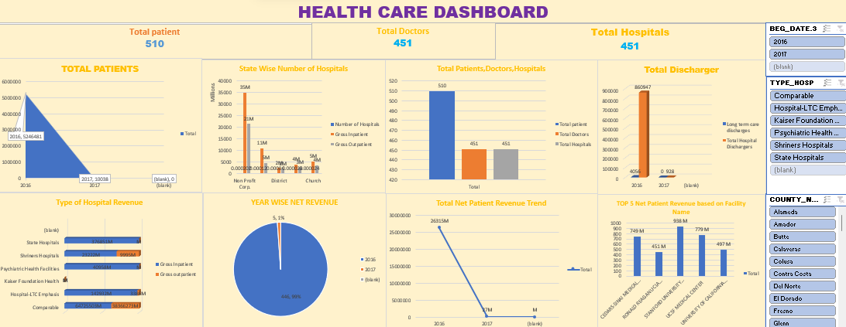
EXCEL DASHBOARD

Slide 5
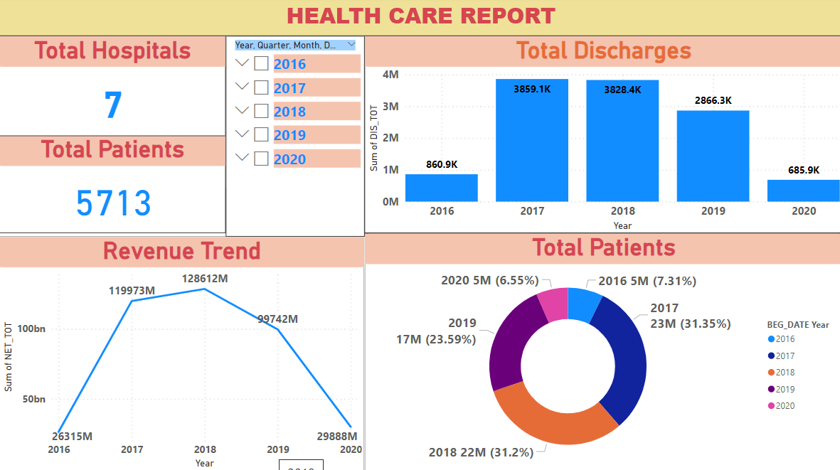
POWER BI DASHBOARD

Slide 6
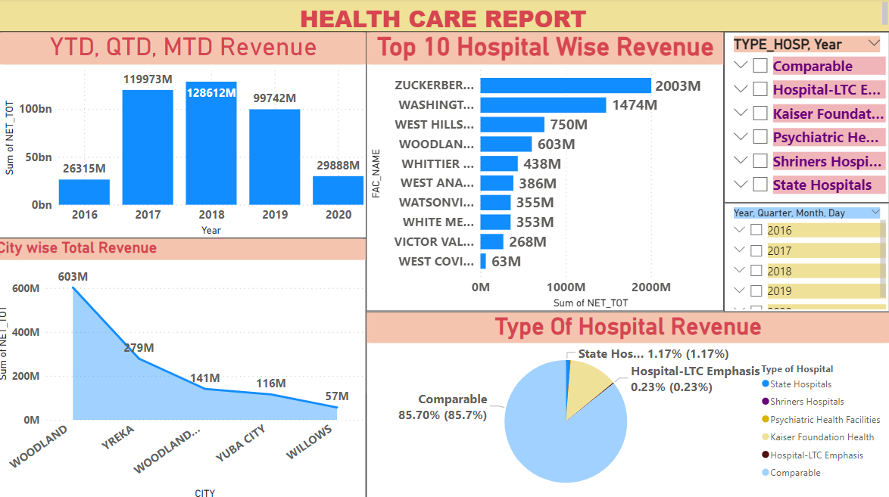
POWER BI DASHBOARD

Slide 7
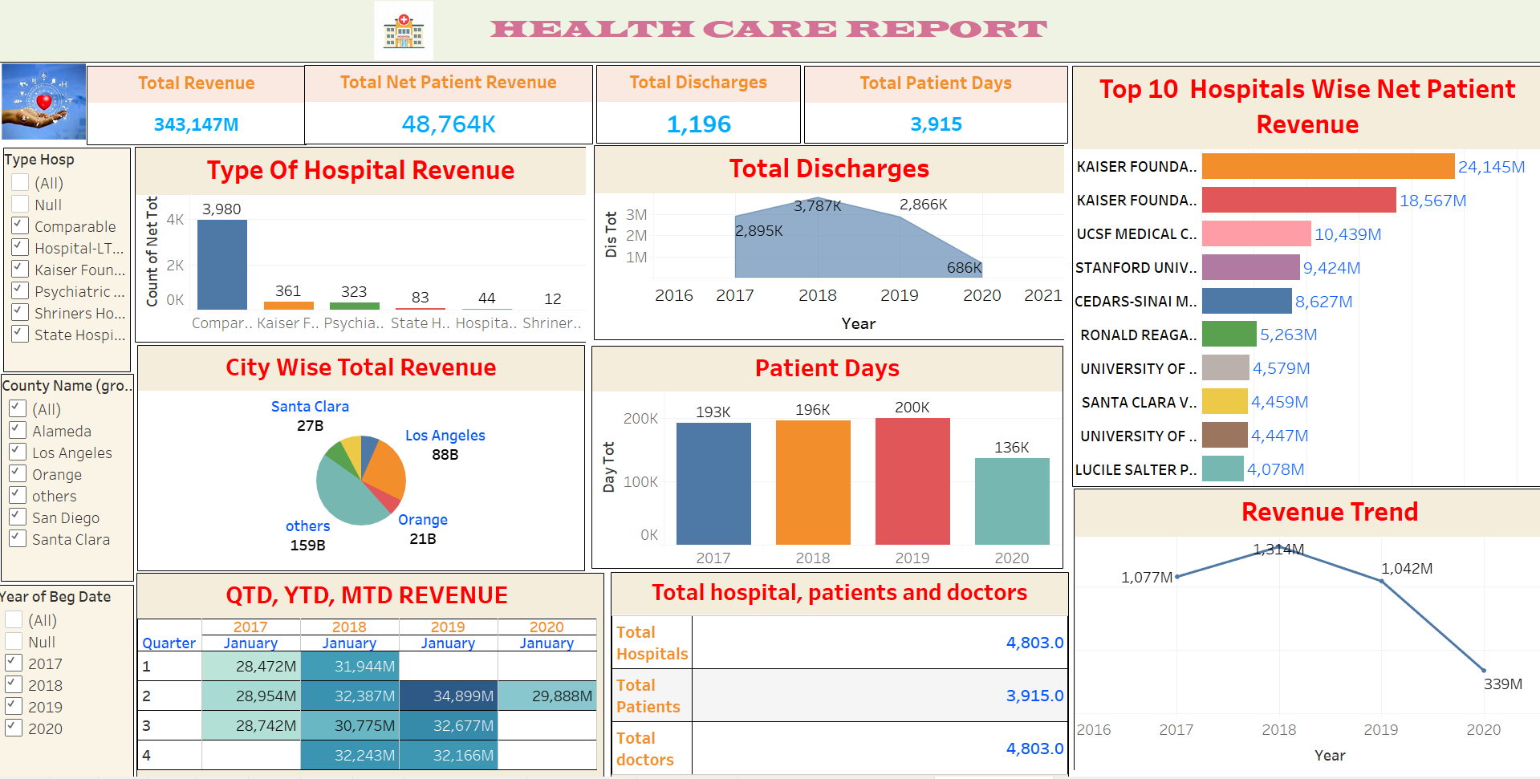
TABLEAU DASHBOARD

Slide 8
Total Discharge
Observation:
A massive drop in total discharges is observed from 860,947 in 2016 to just 928 in 2017.
Outcome:
This could indicate either a drastic reduction in operational capacity, reporting discrepancies, or missing data for 2017.
Needs further investigation to understand whether this drop is due to policy changes, a data issue, or real-world impacts like facility closures.
2016
$860,947
2017
$928

Slide 9
Patient Days
Observation:
Although patient days are not explicitly shown, the drop in patient volume (from 524,681 patients in 2016 to just 10,038 in 2017) suggests fewer patient days overall.
Outcome:
This aligns with the reduced hospital activity seen in 2017, potentially causing significant revenue losses.
2016
524681
2017
10,038

Slide 10
Net Patient Revenue
Observation:
A sharp decline from $2.63 billion in 2016 to $73 million in 2017.
Outcome:
The healthcare system experienced a staggering drop in financial performance in 2017.
This could result in funding shortfalls, operational challenges, and reduced service delivery capacity.
2016
$2.63 Billion
2017
$73 Million

Slide 11
Revenue Trend
Observation:
The trend shows a dramatic revenue decrease between 2016 and 2017, with no revenue reported for the blank category.
Outcome:
This highlights significant instability in revenue generation. Causes could include reduced patient admissions, closure of facilities, or errors in reporting.
Costs
$750 K

Slide 12
State-Wise Number of Hospitals/Revenue
Observation:
Total hospitals: 451.
Revenue leaders include State Hospitals ($3.2 billion gross inpatient) and Comparable Hospitals ($6.4 billion gross inpatient).
Outcome:
State hospitals and Comparable hospitals dominate in revenue, with Comparable Hospitals contributing significantly more.
Church and district hospitals show negligible contributions, highlighting a disparity in revenue distribution.

Slide 13
Type of Hospital Revenue
Observation:
Comparable hospitals generate the highest revenue ($6.4 billion inpatient, $3.8 billion outpatient).
Outpatient revenue is consistently lower across all hospital types.
Outcome:
Focus on optimizing outpatient services could boost revenue further, as inpatient services dominate current income.

Slide 14
MTD/QTD/YTD Revenue
Observation:
These metrics are not explicitly displayed in the dashboard.
Outcome:
Without specific month-to-date or year-to-date details, trends over shorter periods cannot be assessed.
Adding these metrics could help track revenue performance in real time.
Revenue
Jupiter is the biggest planet

Slide 15
Total Patients, Doctors, and Hospitals
Observation:
Patients: 510.
Doctors: 451.
Hospitals: 451.
Outcome:
The ratio of total patients to doctors and hospitals is low. For every hospital and doctor, there’s just over one patient recorded.
This low patient count could be a sign of incomplete data or underutilization of resources.

Slide 16
Overall Insights
Revenue and Patient Discharges:
The dramatic decline in both patient discharges and revenue from 2016 to 2017 raises red flags about system performance.
Hospital Revenue Contribution:
Comparable and State Hospitals are key revenue drivers, suggesting a focus on improving other facility types could help balance contributions.
Data Completeness:
There are blank data points (2017 and blank categories), indicating possible data quality issues that need resolution for accurate reporting.
Resource Utilization:
With 451 hospitals and doctors but only 510 total patients, resource utilization appears extremely low.

Slide 17
Recommendations
Investigate the significant drops in patient count, discharges, and revenue between 2016 and 2017.
Focus on boosting outpatient services to diversify revenue streams.
Ensure data completeness and quality for better trend analysis and decision-making.
Use YTD/MTD revenue metrics for closer monitoring of financial performance.

Slide 18

Thank You

